Slide 1
Care Cottages Customized Software
For phones and laptops

Slide 2
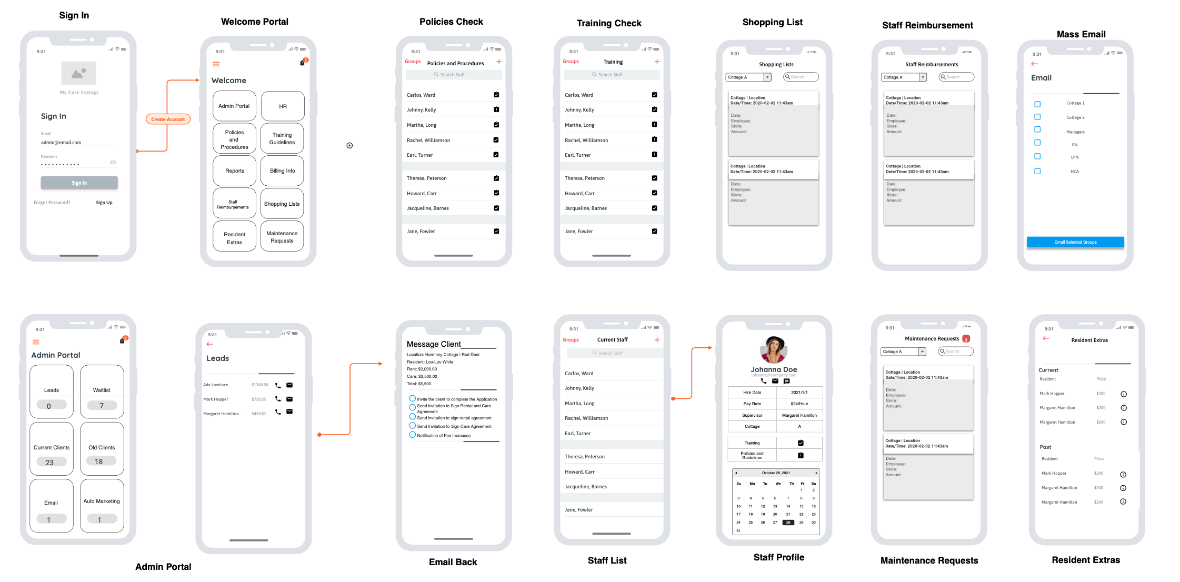
Customized Care Home App for Phones

Slide 3
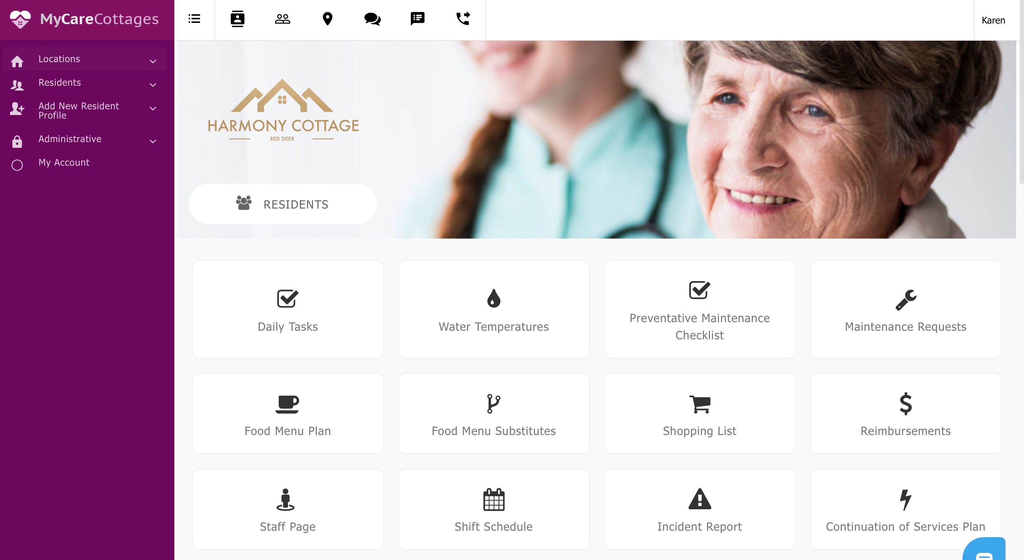
Customized Care Home Software Program

